Slide 1

Database Management System (DBMS)
(Course code: 22CS****R)
CO# 1 ,Session# 3:
Session Topic: Data Independence

Slide 2
Session Objective
Students should be able to understand
The three-levels of database abstraction
The data Independence

Slide 3
Poll Question-01
Q: Which is the lowest level of abstraction that describes how the data are actually stored?
A) Physical
B) Abstract
C) View
D) User

Slide 4
Answer: A
Explanation: The physical level of abstraction that describes how the data are actually stored.

Slide 5
Key Concepts
DBMS Three-Level Architecture
Data Independence
Database Languages

Slide 6
DBMS – Three Level Architecture
A database management system that provides three level of data is said to follow three-level architecture .
  External level (i.e. External Schema)
  Conceptual level (i.e. Conceptual Schema)
  Internal level (i.e. Internal Schema)

Slide 7
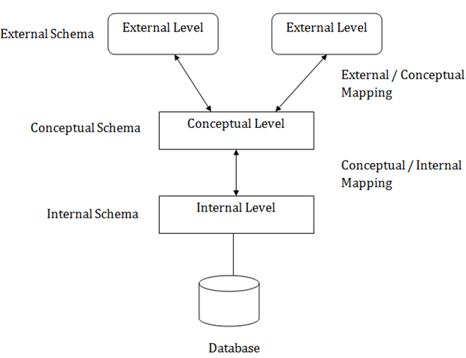
DBMS – Three Level Architecture

Slide 8
External level :
The external level is at the highest level of database abstraction . At this level, there will be many views define for different users requirement. A view will describe only a subset of the database. Any number of user views may exist for a given global or sub schema.
for example , each student has different view of the time table. the view of a student of BTech (CSE) is different from the view of the student of BTech(ECE).Thus this level of abstraction is concerned with different categories of users.
Each external view is described by means of a schema called sub schema or external schema.

Slide 9
Conceptual level :
At this level of database abstraction all the database entities and the relationships among them are included . One conceptual view represents the entire database . This conceptual view is defined by the conceptual schema.
The conceptual schema hides the details of physical storage structures and concentrates on describing entities, data types, relationships, user operations and constraints.
It describes all the records and relationships included in the conceptual view . There is only one conceptual schema per database . It includes feature that specify the checks to relation data consistency and integrity.

Slide 10
Internal level :
It is the lowest level of abstraction closest to the physical storage method used . It indicates how the data will be stored and describes the data structures and access methods to be used by the database . The internal view is expressed by internal schema.
The following aspects are considered at this level:
  Storage allocation e.g: B-tree,hashing
  Access paths eg. specification of primary and secondary keys, indexes etc
  Miscellaneous eg. Data compression and encryption techniques, optimization of the internal structures.

Slide 11
Data Independence
Data independence is the ability to modify the schema without affecting the programs and the application to be rewritten.
Data is separated from the programs, so that the changes made to the data will not affect the program execution and the application.
The main purpose of the three levels of data abstraction is to achieve data independence. If the database changes and expands over time, it is very important that the changes in one level should not affect the data at other levels of the database. This would save time and cost required when changing the database.

Slide 12
There are two levels of data independence based on three levels of abstraction. These are as follows −
  Physical Data Independence
  Logical Data Independence

Slide 13
Physical data independence
Physical data independence is the ability to modify the physical scheme without making it necessary to rewrite application programs. Such modifications include changing from unblocked to blocked record storage, or from sequential to random access files.

Slide 14
Logical data independence
Logical data independence is the ability to modify the conceptual scheme without making it necessary to rewrite application programs. Such a modification might be adding a field to a record; an application program’s view hides this change from the program.

Slide 15
DBMS Languages
Data Definition Language (DDL)
Data Manipulation Language (DML)
  High-Level or Non-procedural Languages: These include the relational language SQL
  Low Level or Procedural Languages:

Slide 16
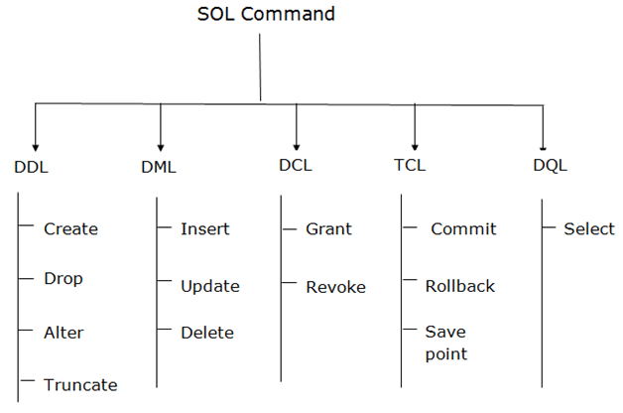

Slide 17
Tools:
Data dictionary / repository:
    Used to store schema descriptions and other information such as design decisions, application program descriptions, user information, usage standards, etc.
    Active data dictionary is accessed by DBMS software and users/DBA.
    Passive data dictionary is accessed by users/DBA only.
  Application Development Environments and CASE (computer-aided software engineering) tools:
    Examples – Power builder (Sybase), Builder (Borland)

Slide 18
Types of DBMS:
Object Based Databases
Hierarchical Databases
Network Databases
Relational Databases

Slide 19
Object based Databases and Hierarchical Databases
Object based databases use concepts such as entities, attributes, and relationships.
Hierarchical Databases: Hierarchical Database model is one of the oldest database models. Information Management System (IMS) is based on this model

Slide 20
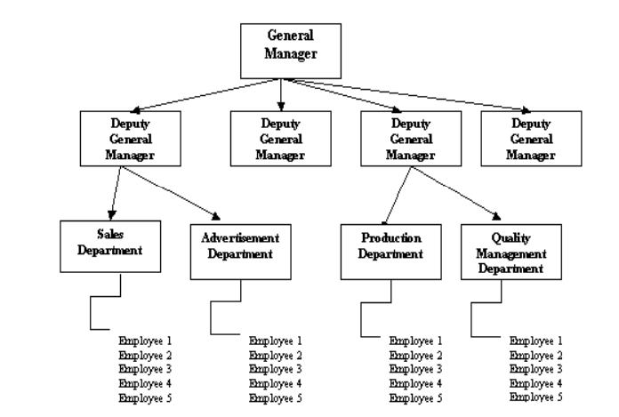
Example:

Slide 21
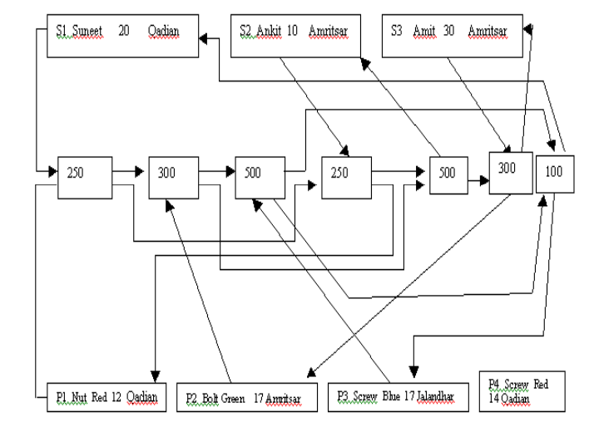
Network Databases:
The Network Databases represents data with a graph. The main difference of the network model from the hierarchical model, is its ability to handle many to many (N:N) relations

Slide 22
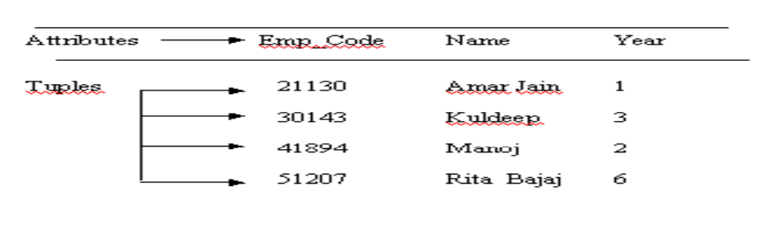
Relational Databases:
Relational Databases stores data in the form of tables. This concept purposed by Dr. E.F. Codd, a researcher of IBM in the year 1960 s

Slide 23
References
Database System Concepts, Sixth Edition, Abraham Silberschatz, Yale University Henry, F. Korth Lehigh University, S. Sudarshan Indian Institute of Technology, Bombay.
Fundamentals of Database Systems, 7th Edition, RamezElmasri, University of Texas at Arlington, Shamkant B. Navathe, University of Texas at Arlington.

